Slide 1

Shanghai Qipang Industrial Co., Ltd
Pay off machine
Applications:
For use in fully automatic terminal crimping machines, computerized wire cutting machines, and soldering machines.

Slide 2
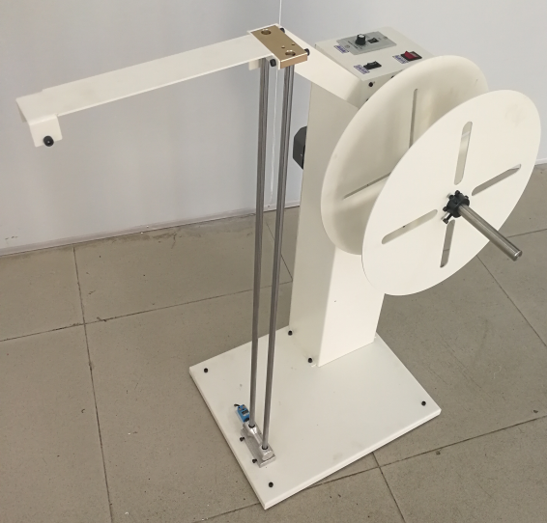
Series 1: Single-wire pay-off machine
Model: QP-1
Motor: 120W
Power Supply: 220V 50/60Hz
Wire Diameter: Within 6.0mm
Load Capacity: 20kg
Speed: Maximum 1 m/s
Speed ​​Gears: 10, automatic sensing with independent brake.
Cable Width: Customizable
Spool Diameter: Maximum 500mm
Spool Width: Within 200mm
Spool Inner Diameter: 400mm spool inner diameter 120mm-300mm; 500mm spool inner diameter 120-400mm
Cable Storage Length: Approximately 3.5m with pulley
Net Weight: 32KG
Gross Weight: 59KG
Dimensions: Length 600*Width 500*Height 950mm
Packaged Dimensions: Length 604*Width 504*Height 950mm
Functions: Single wire feeding, can feed spools, can feed loose wire

Slide 3
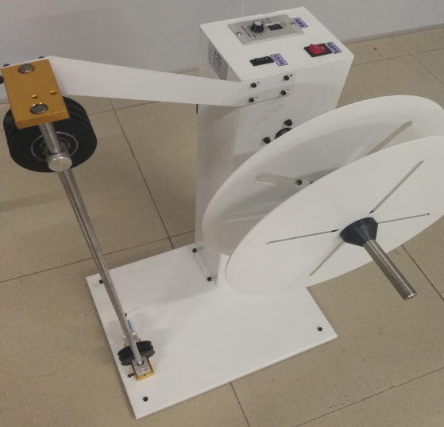
Series 2: Single-line + One-set-reel pay-off machine
Model: QP-2
Motor: 120W
Power Supply: 220V 50/60Hz
Wire Diameter: Within 6.0mm
Load Capacity: 20kg
Speed: Maximum 2m/s
Speed ​​Gears: 10, Automatic Sensing with Independent Brake
Wire Width: Customizable
Spool Diameter: Maximum 500mm
Spool Width: Within 200mm
Spool Inner Diameter: 400 spools can hold 120mm-300mm wire; 500 spools can hold 120-400mm wire
Wire Storage Length: Approximately 3.5m with pulley
Net Weight: 33.5KG
Gross Weight: 60KG
Dimensions: Length 600*Width 500*Height 950mm
Packaged Dimensions: Length 604*Width 504*Height 950mm
Functions: Single wire feeding + wire storage function; can hold spools and loose wires.

Slide 4
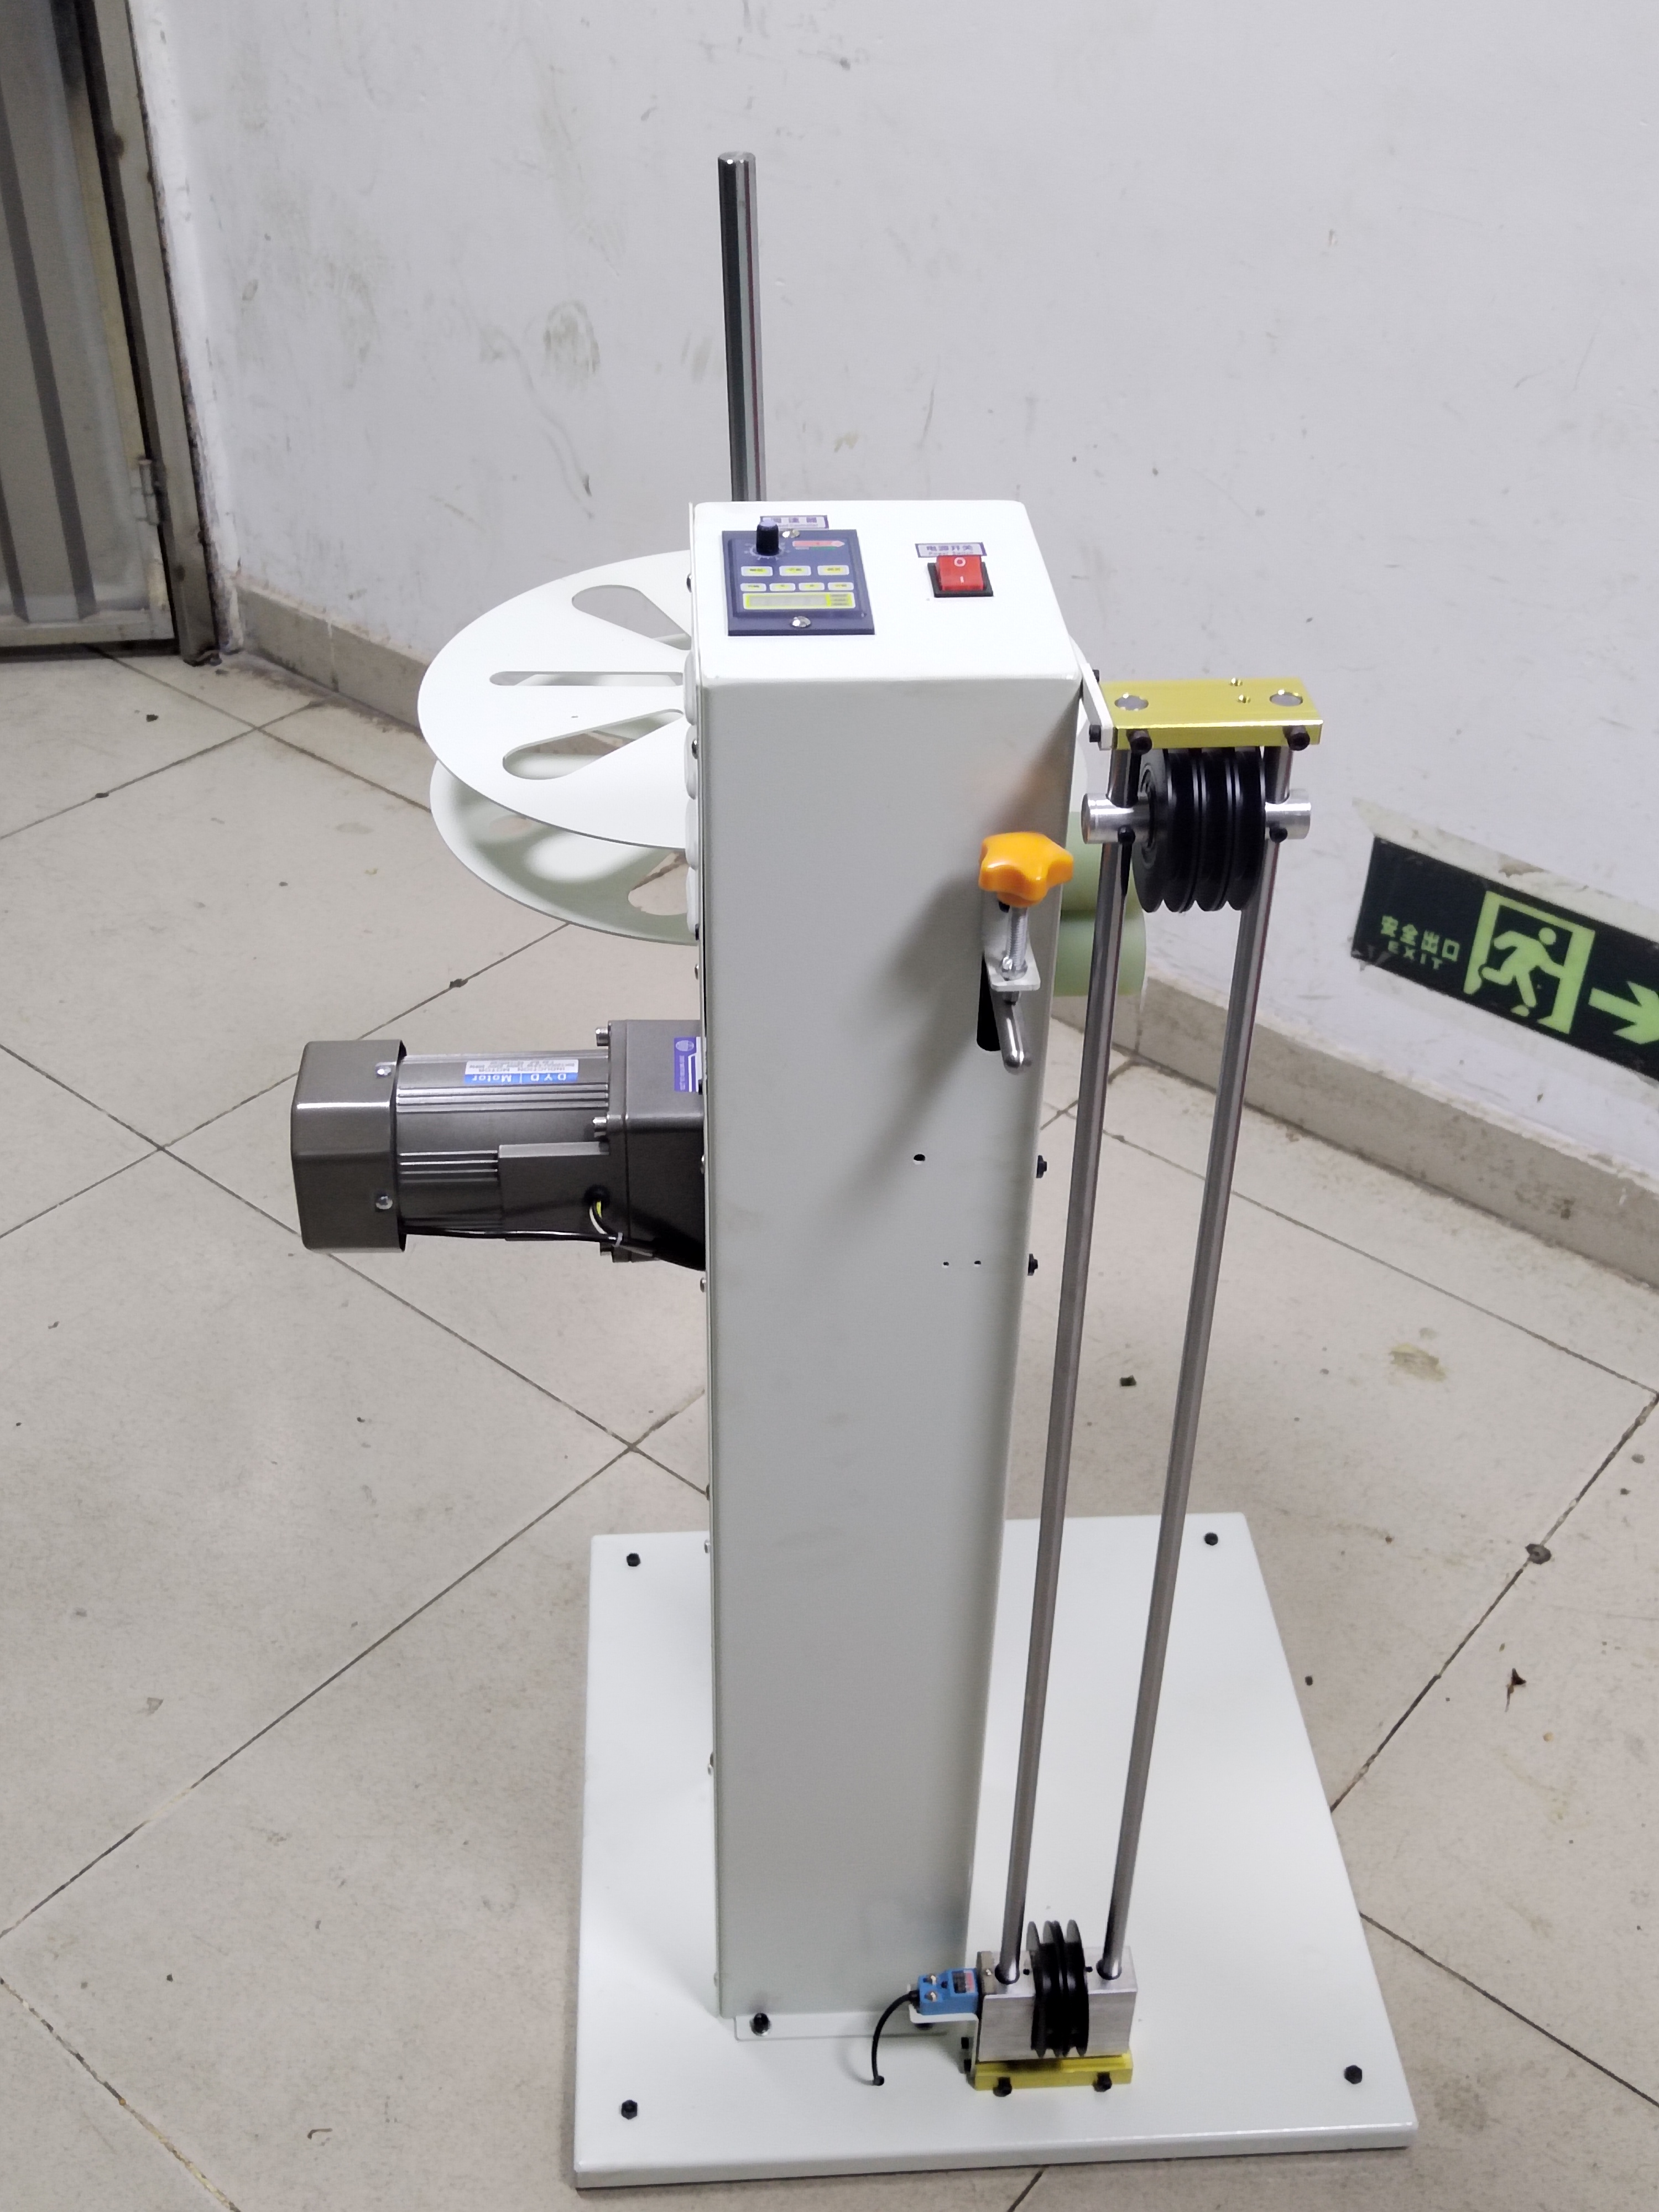
Series 3: Horizontal and Vertical pay-off machine
Model: QP-3
Motor: 120W
Power Supply: 220V 50/60Hz
Wire Diameter: 6.0mm or less
Load Capacity: 20kg
Speed: Maximum 2m/s, bidirectional drive, wire guide wheel speed-up setting, with 3K reduction gearbox.
Speed ​​Gears: 10, automatic sensing with independent brake.
Wire Width: Customizable.
Spool Diameter: Maximum 500mm
Spool Width: Within 200mm
Spool Inner Diameter: Minimum 30mm
Wire Storage Length: Approximately 3.5m with pulley
Net Weight: 45KG
Dimensions: 610*570*950mm
Functions: 1. Horizontal/vertical wire feeding 2. Active wire feeding 3. Pre-feeding 4. Silent start, noise level below 30db
5. The intelligent delay function ensures smooth acceleration during braking, preventing cable damage.

Slide 5
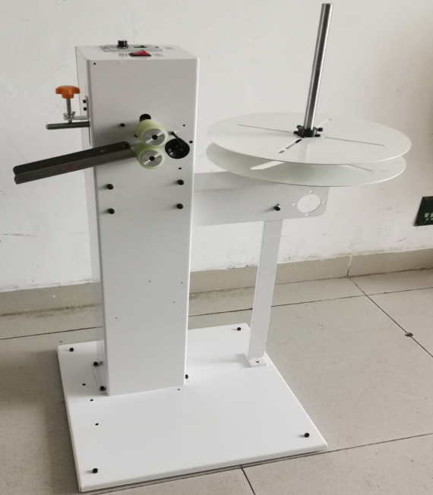
Series 4: Wire Pay off Machine
Model: QP-4
Motor: 120W
Power Supply: 220V 50/60Hz
Wire Diameter: 6.0mm or less
Load Capacity: 20kg
Speed: 200m wire in 5 minutes
Speed ​​Gear: 10 speeds
Wire Width: Customizable
Spool Diameter: Maximum 500mm
Spool Width: 200mm or less
Spool Inner Diameter: 400 spools can hold 120mm-300mm wire; 500 spools can hold 120-400mm wire
Net Weight: 38KG
Gross Weight: 58KG
Dimensions: 610*570*950mm
Functions: 1. Horizontal/vertical wire feeding
2. Active wire feeding
3. Can hold spool wire and loose wire

Slide 6
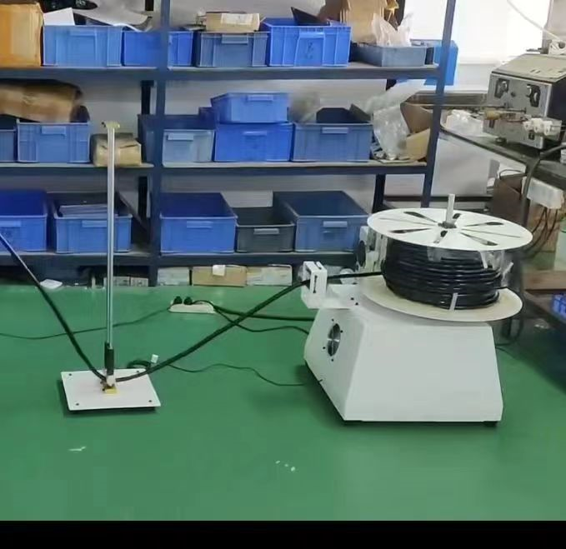
Series 5: Pipe Pay off Machine
Model: QP-5
Motor: 180W
Power Supply: 220V 50/60Hz
Wire Diameter: 15mm
Load Capacity: 20kg
Speed: Maximum 1m/s
Speed ​​Gears: 10, Automatic Sensing with Independent Brake
Spool Diameter: Within 800mm
Spool Width: Within 200mm
Spool Inner Diameter: Minimum 30mm
Spool Weight: Maximum 20kg
Net Weight: 32kg
Dimensions: 500*650*850mm

Slide 7
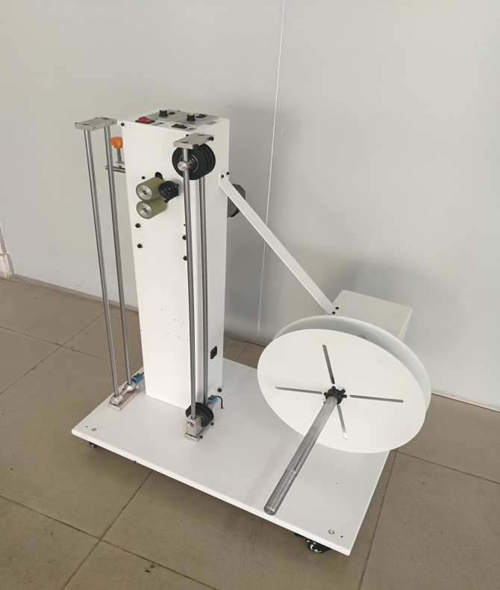
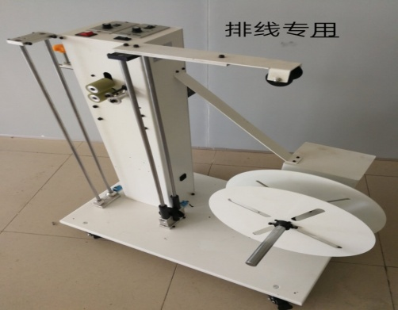
Series 6: Dual-Motor
Model: QP-6
Motor: Front motor with wire guide wheel 120W, rear motor driving spool 180W
Power Supply: 220V 50/60Hz
Wire Diameter: 6.0mm or less
Load Capacity: 25kg
Speed: ??
Speed ​​Gears: 10, with automatic sensing and braking
Wire Width: 25mm or less
Spool Diameter: Maximum 400mm
Spool Width: 200mm or less
Spool Inner Diameter: 400 spools can hold 120mm-300mm wire; 500 spools can hold 120-400mm wire
Wire Storage Length: Approximately 3.5m with pulley
Spool Diameter: 25mm
Dimensions: 800*630*1003mm
Functions: Active wire feeding, can be used with wire feeding, can hold spools, loose wires, and lead wires; has a dedicated wire feeding function.

Slide 8
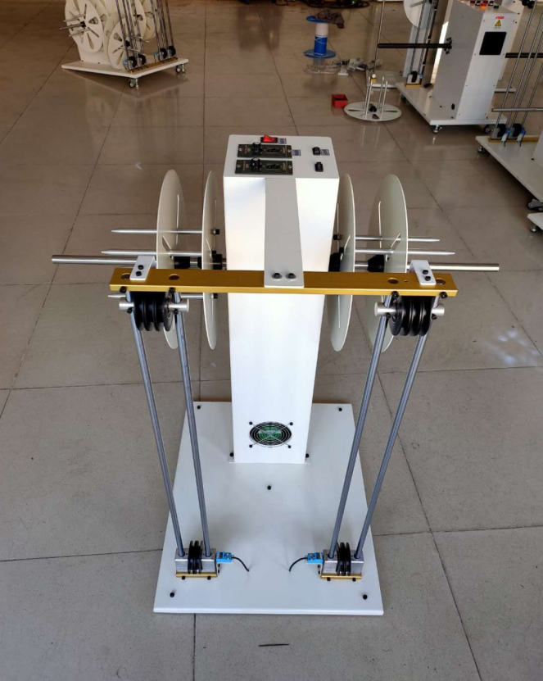
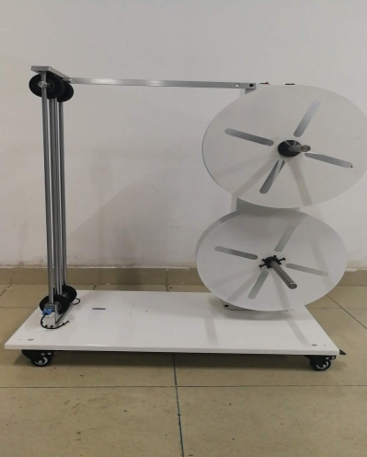
Series 7: Double-Wire Pay off Machine
Model: QP-7
Motor: 120W, Dual Motors with Imported European Wheels
Power Supply: 220V 50/60Hz
Load Capacity: 20 kg
Wire Diameter: Within 6.0mm
Wire Width: Customizable
Speed: Maximum 1 m/s
Speed ​​Gears: 10 speeds, automatic sensing with independent brake
Spool Diameter: Maximum 500mm
Spool Width: Within 200mm
Spool Inner Diameter: 400 spools can hold 120mm-300mm wire, 500 spools can hold 120-400mm wire
Wire Storage Length: Approximately 3.5m with wheels.
Machine Dimensions: Length: 920*650*950mm
Functions: Active wire feeding, wire feeding in conjunction with wire unloading, simultaneous wire unloading and separate wire unloading, can unload spools and loose wires.

Slide 9
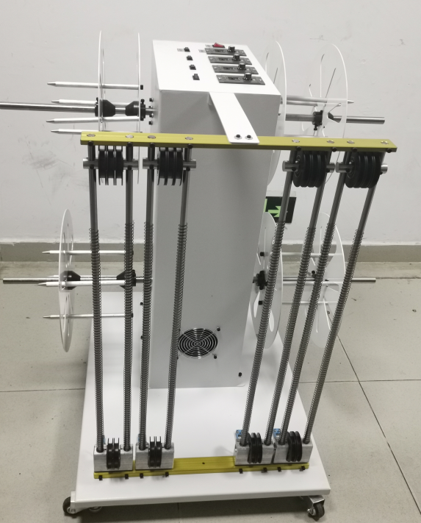
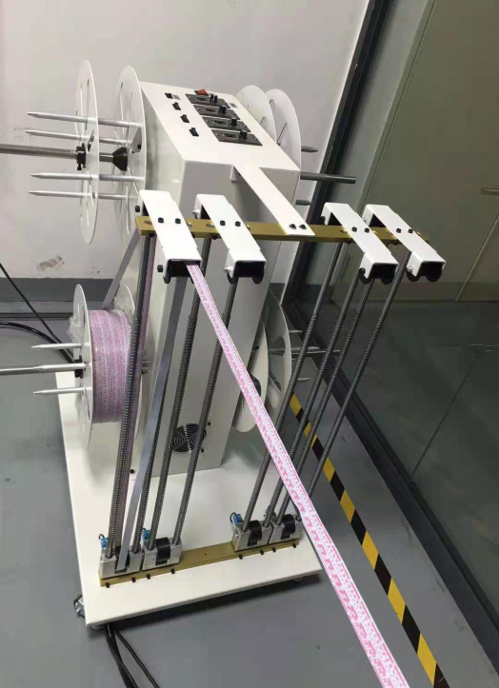
Series 8: Four-wire pay-off machine
Model: QP-8
Motor: 120W, four motors, medium to large motors
with imported European pulleys
Power Supply: 220V 50/60Hz
Wire Diameter: 6.0mm or less
Load Capacity: 20kg
Speed ​​Gears: 10, automatic sensing with independent brake.
Cable Width: Customizable.
Spool Diameter: Maximum 400mm
Spool Width: 200mm or less
Spool Inner Diameter: 120mm-300mm
Cable Storage Length: Approximately 3.5m with pulleys
Dimensions: 860*1000*1030mm
Functions: Can be used in conjunction with cable feeding or
as a standalone cable feeder.

Slide 10
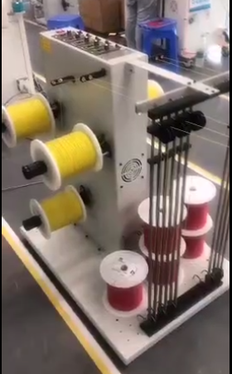
Series 9: Five-axis
Model: QP-9
Motor: 120W, 5 motors
Power Supply: 220V 50/60Hz
Wire Diameter: 6.0mm or less
Load Capacity: 15KG
Speed: Maximum 2m/s
Speed ​​Gears: 10, automatic sensing with independent brake.
Cable Width: Customizable.
Spool Diameter: Maximum 400mm
Spool Width: 200mm or less
Spool Inner Diameter: 120mm-300mm
Cable Storage Length: Approximately 3.5m with pulley
Dimensions: 990*860*1050mm
Function: Can be used simultaneously for cable feeding or as a standalone cable feeder.

Slide 11
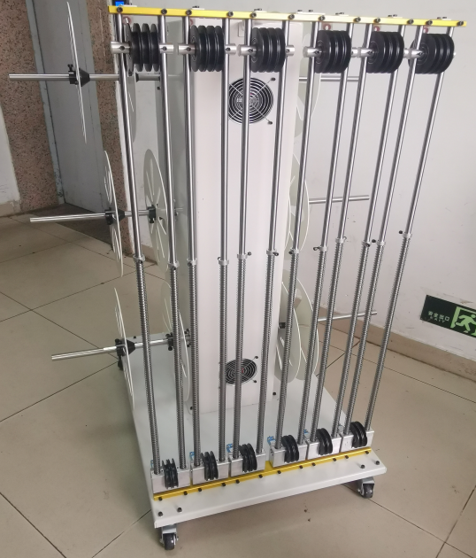
Series 10: Six-axis
Model: QP-10
Motor: 120W, 6 motors
Power Supply: 220V 50/60Hz
Wire Diameter: 6.0mm or less
Load Capacity: 15KG
Speed: Maximum 2m/s
Speed ​​Gears: 10, automatic sensing with independent brake.
Cable Width: Customizable.
Spool Diameter: Maximum 400mm
Spool Width: 200mm or less
Spool Inner Diameter: 120mm-300mm
Cable Storage Length: Approximately 3.5m with pulley
Dimensions: 990*860*1050mm
Function: Can be used simultaneously for cable feeding or as a standalone cable feeder.

Slide 12
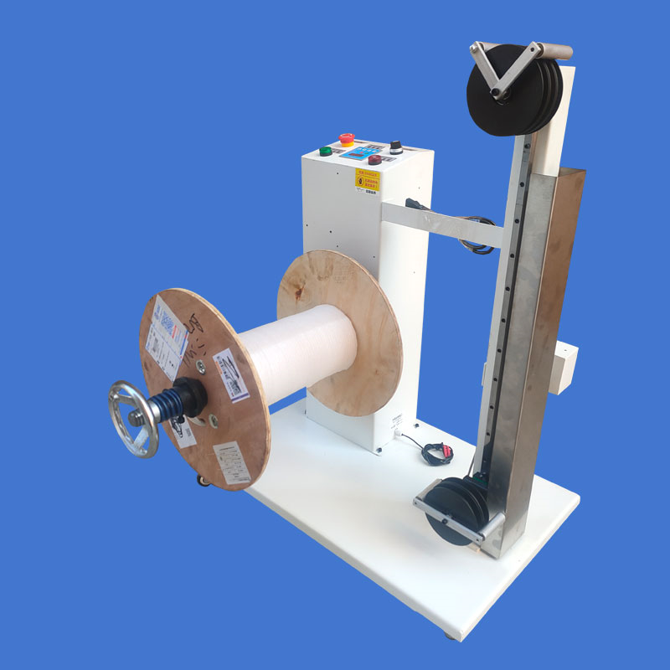
Series 11: Vertical Continuously Variable Speed ​​Cable Paying Machine
Model: QP-11
Motor: 750W
Power Supply: 220V 50/60Hz
Wire Diameter: 6.0mm or less
Load Capacity: 50KG
Speed: Maximum 4m/s, stepless speed regulation
Wire Width: Customizable upon request
Spool Diameter: Maximum 500mm
Spool Width: Within 300mm
Spool Inner Diameter: 400 spools can hold 120mm-300mm wire; 500 spools can hold 120-400mm wire
Wire Storage Length: Approximately 3.5m with pulley
Dimensions: 670*800*1030mm
Functions: Active wire feeding, automatic sensing with brake, uniform speed guide rail, resistance-free operation. Low noise; adjustable pulleys according to wire diameter. Stepless speed regulation at 4m/s, no manual speed adjustment required. Can be connected to an automatic machine for automatic stop with brake and alarm.

Slide 13
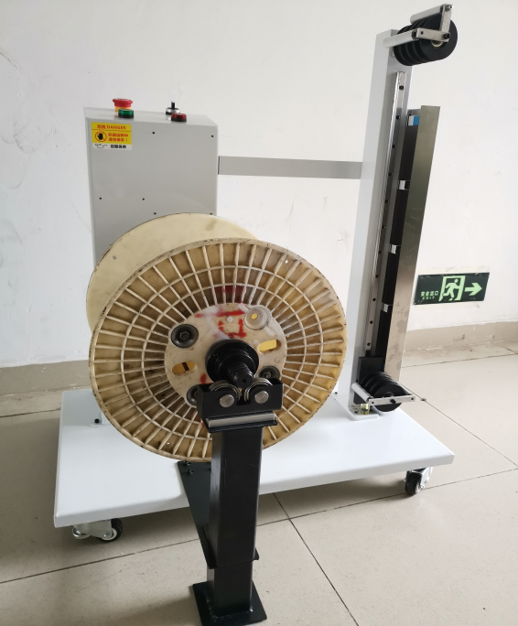
Series 12: Vertical Continuously Variable Transmission
Model: QP-12
Motor: 750W
Power Supply: 220V 50/60Hz
Wire Diameter: 6.0mm or less
Load Capacity: 60KG
Speed: Maximum 4m/s, stepless speed regulation
Wire Width: Customizable upon request
Spool Diameter: Maximum 500mm
Spool Width: Within 300mm
Spool Inner Diameter: 400 spools can hold 120mm-300mm wire; 500 spools can hold 120-400mm wire
Wire Storage Length: Approximately 3.5m with pulley
Dimensions: 670*800*1030mm
Functions: Active wire feeding, automatic sensing with brake, uniform speed guide rail, resistance-free operation. Low noise; adjustable pulleys according to wire diameter. Stepless speed regulation at 4m/s, no manual speed adjustment required. Can be connected to an automatic machine for automatic stop with brake and alarm.

Slide 14
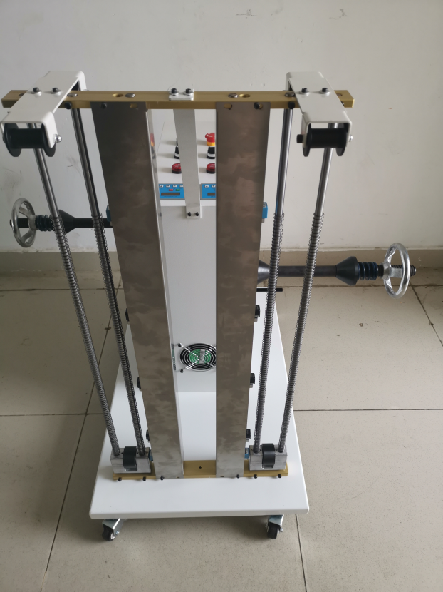
Series 13: Dual-wire Continuously Variable Transmission
Model: QP-13
Motor: 550W, Dual Motors
Power Supply: 220V 50/60Hz
Wire Diameter: Up to 6.0mm
Load Capacity: 40KG+40KG
Speed: Maximum 4m/s, Stepless Speed ​​Control
Wire Width: Customizable
Spool Diameter: Maximum 500mm
Spool Width: Up to 300mm
Spool Inner Diameter: 400 spools can hold 120mm-300mm wire; 500 spools can hold 120-400mm wire
Wire Storage Length: Approximately 3.5m with pulley
Dimensions: 1100*840*1020mm
Functions: Active wire feeding, automatic sensing with brake, uniform speed guide rail, resistance-free operation. Low noise; adjustable pulleys according to wire diameter. Stepless speed control at 4m/s, no manual adjustment required. It can be connected to an automatic machine, with automatic stopping, brake, and alarm.

Slide 15
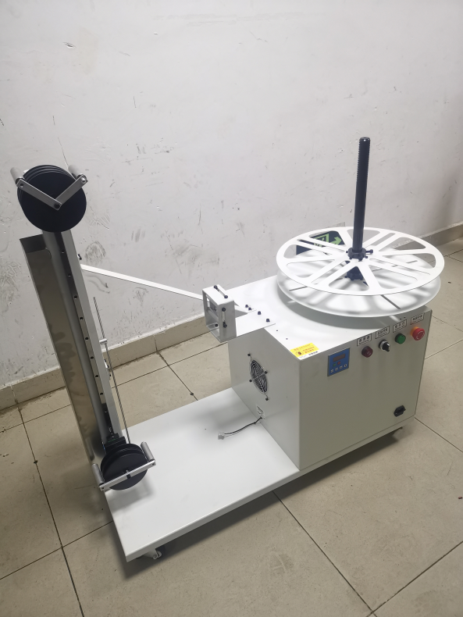
Series 14: Horizontal Continuously Variable Transmission
Model: QP-14
Motor: 750W
Power Supply: 220V 50/60Hz
Wire Diameter: Within 6.0mm
Load Capacity: 50KG
Speed: Maximum 4m/s, stepless speed regulation
Cable Width: Customizable upon request.
Spool Diameter: Maximum 700mm
Spool Width: Within 300mm
Spool Inner Diameter: 400 spools can hold 120mm-300mm wire, 500 spools can hold 120mm-400mm wire, 600 spools can hold 120-5000mm wire, 700 spools can hold 120mm-600mm wire
Wire Storage Length: Approximately 3.5m with pulley
Dimensions: 1020*520*1050mm
Gross Weight: 112KG
Functions: Active wire feeding, automatic sensing with brake, uniform speed guide rail, resistance-free operation. Low noise level; the reel can be adjusted according to wire diameter. Stepless speed regulation at 4 meters per second, no manual speed adjustment required. Can be connected to an automatic machine with automatic stop, brake, and alarm.

Slide 17
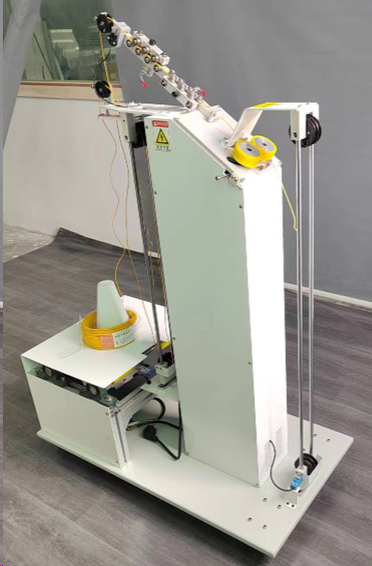
Series 15: Intelligent Dual-Purpose Fine
Model:QP-15
Motor: Front motor driving the wire guide wheel 120W, rear motor driving the spool 180W
Power Supply: 220V 50/60Hz
Wire Diameter: Within 2.0mm
Load Capacity: 25kg
Speed: ?
Speed ​​Gears: 10, automatic sensing with independent brake.
Wire Width: Customizable.
Spool Diameter: Maximum 500mm
Spool Width: Within 200mm
Spool Inner Diameter: Minimum 30mm
Wire Storage Length: Approximately 3.5m with pulley
Dimensions: 800*630*1003mm
Functions: 1. Horizontal/vertical wire feeding 2. Active wire feeding 3. Pre-feeding 4. Smooth acceleration during braking to prevent wire damage 5. With straightening pulley

Slide 18
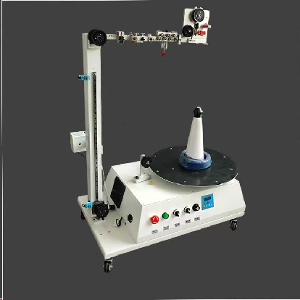
Series 16: Fine Wire Dual-Purpose Stepless Speed ​​
Model: QP-16
Motor: 550W
Power Supply: 220V 50/60Hz
Wire Diameter: 12.0mm or less
Load Capacity: 50KG
Speed: Maximum 4m/s, stepless speed regulation
Wire Width: Customizable upon request
Spool Diameter: 500mm
Spool Width: 300mm or less
Spool Inner Diameter: 400 spools can hold 120mm-300mm wire, 500 spools can hold 120mm-400mm wire; Wire Storage Length: Approximately 3.5m with pulley
Dimensions: 520*880*1160mm
Functions: Horizontal/vertical wire feeding, active wire feeding, and wire take-up. Automatic sensing with brake, uniform speed on the guide rail, and resistance-free operation. Low noise; adjustable pulleys according to wire diameter. Stepless speed regulation at 4m/s, no manual speed adjustment required. It can be connected to an automatic machine, with automatic stopping, brake, and alarm.

Slide 19
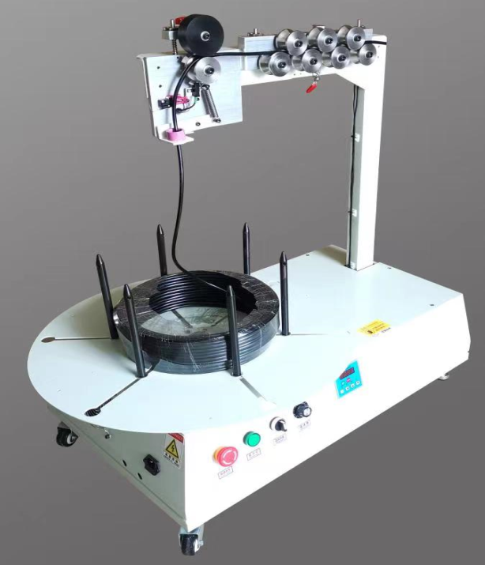
Series 17: New Energy Intelligent Resistance-Free
Model: QP-17
Motor: 550W
Power Supply: 220V 50/60Hz
Wire Diameter: Within 12.0mm
Load Capacity: 50KG
Speed: Maximum 4m/s, stepless speed regulation
Wire Width: Customizable upon request
Spool Diameter: 500mm
Spool Width: Within 300mm
Spool Inner Diameter: 400 spools can hold 120mm-300mm wire, 500 spools can hold 120mm-400mm wire; Wire Storage Length: Approximately 3.5m with pulley
Dimensions: 670*800*1030mm
Functions: Active wire feeding, automatic sensing with brake, uniform speed guide rail, resistance-free operation. Low noise; adjustable pulley according to wire diameter. Stepless speed regulation at 4m/s, no manual speed adjustment required. Can be connected to an automatic machine for automatic stop with brake and alarm.

Slide 20
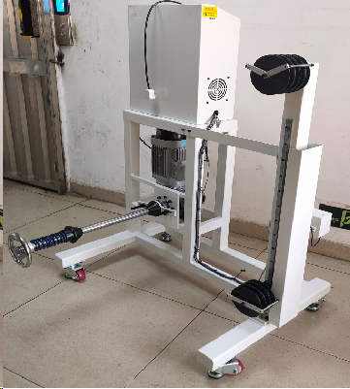
Series 18: Intelligent Load-Bearing Continuously Variable Transmission
Model: QP-18
Motor: 1250W
Power Supply: 220V 50/60Hz
Wire Diameter: 6.0-20.0mm
Load Capacity: 100KG
Speed: Maximum 6m/s, stepless speed regulation
Cable Width: Customizable upon request.
Spool Diameter: Maximum 500mm
Spool Width: Within 300mm
Spool Inner Diameter: 400 spools can hold 120mm-300mm, 500 spools can hold 120mm-400mm
Cable Storage Length: Approximately 3.5m with pulley
Dimensions: 920*880*1360mm
Functions: Active cable feeding; can be modified for cable laying with cable feeding. Automatic sensing with brake, uniform speed on the guide rail, no resistance. Low noise; the pulley can be adjusted according to the wire diameter. Stepless speed regulation, no manual adjustment required. It can be connected to an automatic machine, with automatic stopping, brake, and alarm.

Slide 21
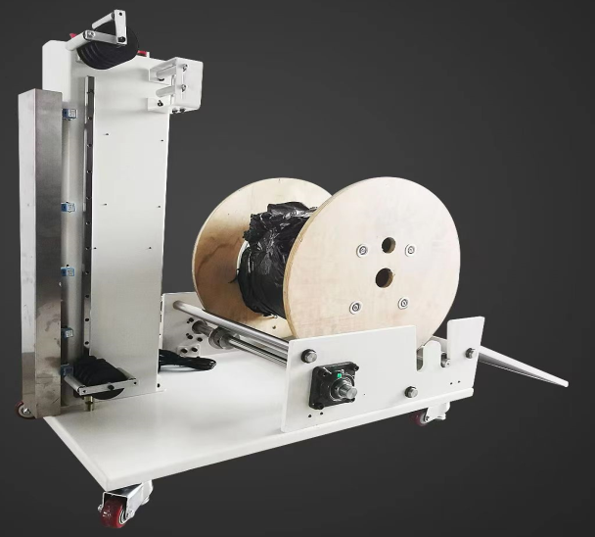
Series 19: Lightweight Ground-Mounted Cable Laying Machine
Model: QP-19
Motor: 750W
Power Supply: 220V 50/60Hz
Wire Diameter: 16.0mm
Load Capacity: 100KG
Speed: Maximum 2m/s, stepless speed regulation
Cable Width: Customizable upon request.
Spool Diameter: Maximum 630mm
Spool Width: Within 480mm
Spool Inner Diameter: 400 spools can hold 120mm-300mm, 500 spools can hold 120mm-400mm
Cable Storage Length: Approximately 3.5m with pulley
Dimensions: 960*810*1050mm
Gross Weight: 215KG
Functions: Active cable feeding; can be modified for cable laying with cable feeding. Automatic sensing with brake, uniform speed guide rail, no resistance. Low noise; adjustable pulley according to wire diameter. Stepless speed regulation, no manual adjustment required. It can be connected to an automatic machine, with automatic stop, brake, and alarm.。

Slide 22
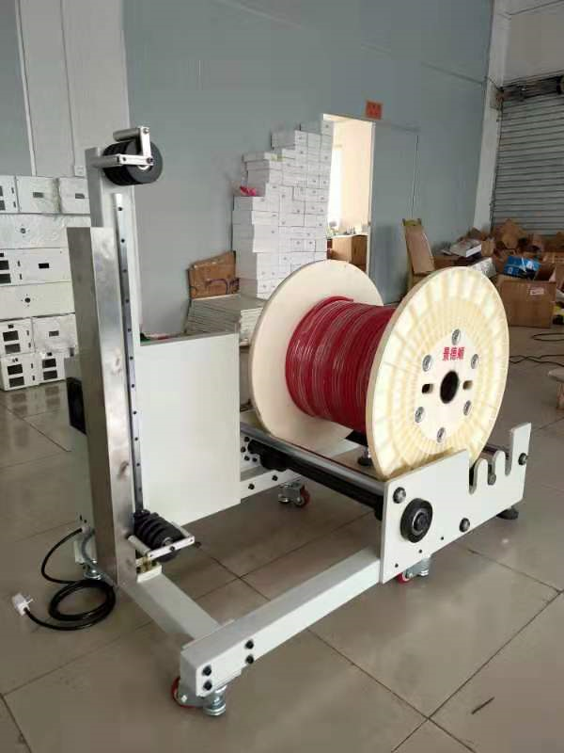
Series 20: Heavy-duty ground-supported
Model:QP-20
Motor: 750W
Power Supply: 220V 50/60Hz
Wire Diameter: 16.0mm
Load Capacity: 250KG
Speed: Maximum 2m/s, stepless speed regulation
Cable Width: Customizable upon request.
Spool Diameter: 800mm
Spool Width: Within 600mm
Spool Inner Diameter: 400 spools can hold 120mm-300mm wire, 500 spools can hold 120mm-400mm wire, 600 spools can hold 120-5000mm wire, 700 spools can hold 120mm-600mm wire
Wire Storage Length: Approximately 3.5m with pulley
Dimensions: 1240*920*1050mm
Functions: Active wire feeding; can be modified to feed bundled wires. Automatic sensing with brake, uniform speed guide rail, no resistance. Low noise; the reel can be adjusted according to wire diameter. Stepless speed regulation, no manual adjustment required. Can be connected to an automatic machine with automatic stop, brake, and alarm.

Slide 23
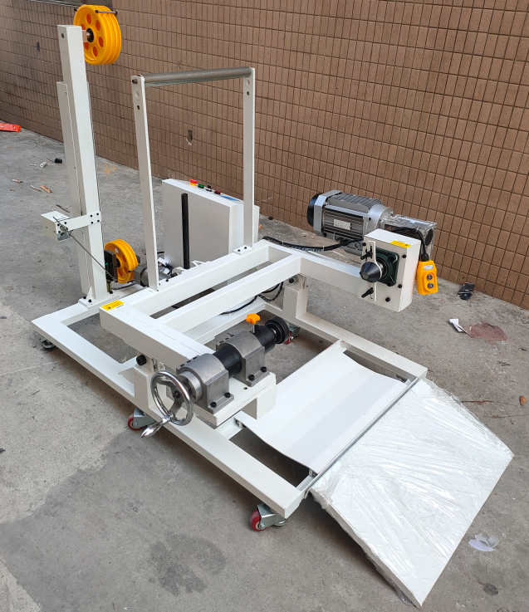
Series 21: New Energy Lifting Heavy-Duty
Model: QP-21
Total Power: 2370W (Motor 2200W + Switching Power Supply 50W + Lifting Motor 120W)
Power Supply: AC 380V
Load Capacity: 300KG
Reducer Wire Loading Cone Diameter: 80mm
Main Shaft: ￠40mm, Applicable spool diameter 400-800mm, width 350-550mm
Slide Rail Stroke: 700mm
Wire Storage Wheel Diameter: 200mm (7 can be customized)
Wire Storage Wheel Wire Passing Groove Width: 8mm
Net Weight: Approx. 150KG
Dimensions: 1700*1300*1200mm
Functions:
1. Variable frequency lifting automatic wire feeding
2. Forward and reverse rotation control
3. Variable frequency motor brake
4. Adaptive speed adjustment: the higher the slider position, the faster the motor speed; the lower it position, the slower the motor speed.
5. Anti-knotting sensor.
6. Can be connected to a front wire stripper for simultaneous shutdown.

Slide 25
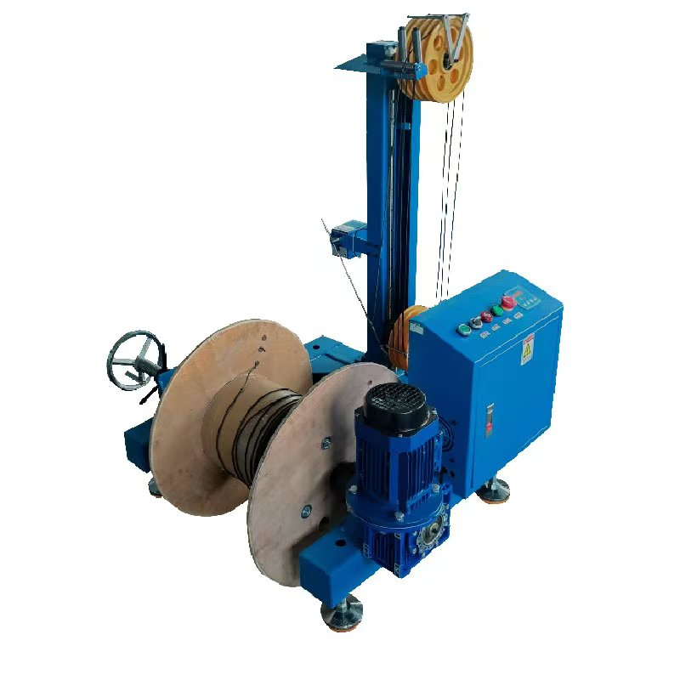
Series 22: Heavy-duty 630 double-wire pay-off machine
Power supply: 220V 50/60Hz, Motor: 750W,
Dimensions: 1260*950*1360mm,
Weight: Approximately 86 kg.
Suitable wire feed: Inner diameter 40-95mm, Outer diameter: 300-630mm, Width: 230-450mm,
Load capacity: 150KG, Active wire feed, Manual wire feed, Automatic sensing with brake, Uniform guide rail speed, No resistance, Low noise, Adjustable reel for different wire diameters.
Wire diameter: Up to 12.0mm, Stepless speed regulation (3 meters per second), Automatic speed control, no manual adjustment required.
Can be connected to an automatic machine, with automatic stop and brake, and alarm.
QP-21

Slide 26
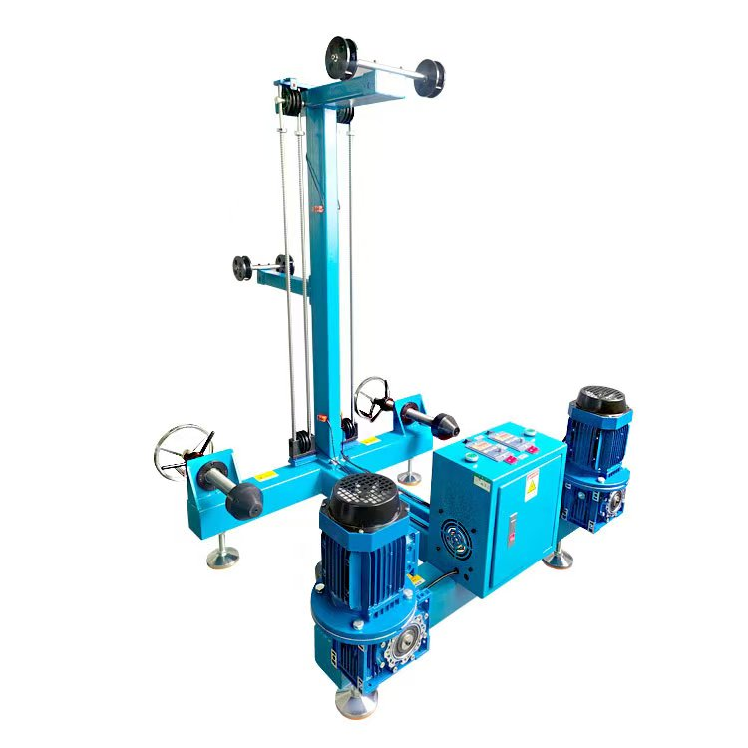
Series 23: Heavy-duty 630 Double-wire
Dimensions: 1010mm (L) * 1370mm (W) * 1480mm (W)
Weight: 127kg
Power: 1500KW
Voltage: 220V
Motor: 750W
Inverter: 750W
Load Capacity: 100KG per side, Total Weight: 200kg
Speed: 3 meters per second
Wire Feeding Specifications: 1-5mm wire diameter
Universal Axis Shaft Specifications: Inner diameter 40-90mm, Diameter 300-630mm, Height 230-450mm
Automatic speed control, no manual adjustment required. Automatic or manual wire feeding. Automatic sensor with brake and alarm.
QP-23

Slide 27
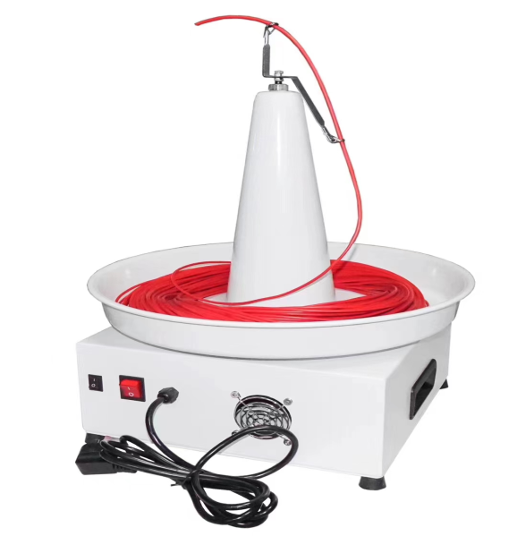
Series 24: Electric Pay-off Reel
QP-24
Power supply: 220V; Dimensions: 390*390*500mm; Diameter: 1-2mm; Wire length: not exceeding 500mm
Applications:
Fully automatic terminal crimping machine, computerized wire cutting machine, soldering machine

Slide 28
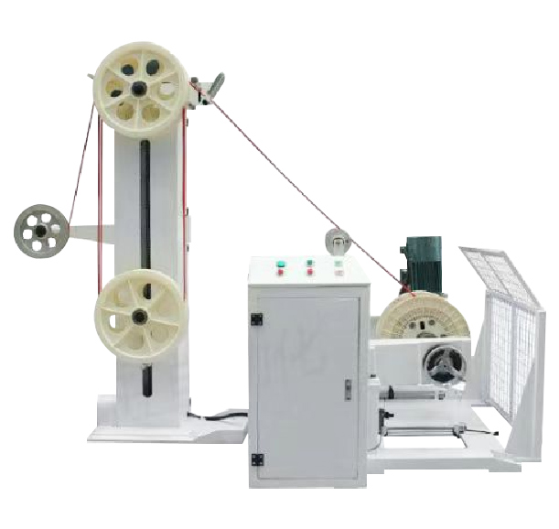
QP-800 Wire Reel Pay-off Machine
New energy vehicle cables, charging pile cables, power cables, photovoltaic cables, BV and other larger cables
Features:
Stepless speed regulation, smooth operation
Independent system, can complete pay-off without host control
High-quality motor, fast response, high speed
Can choose vertical and swing arm pay-off stands according to wire material
Technical Specifications:
Applicable wire diameter: φ3-φ20
Power supply: AC380V 50Hz/60Hz
Feeding speed: 250m/min
Machine weight: Pay-off machine: approx. 550Kg
Load capacity: 1T
Overall dimensions: Pay-off machine: 1300*1280*1220mm
Applicable reel size: Outer diameter φ500-φ800 Width 300-600
Power: ≈4kW

Slide 29
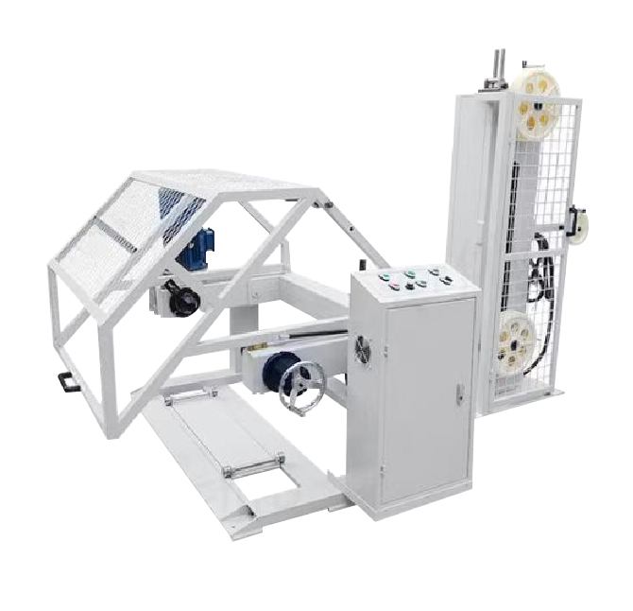
QP-1000 Wire Reel Pay-off Machine
New energy vehicle cables, charging pile cables, power cables, photovoltaic cables, BV wires and other larger cables
Stepless speed regulation, smooth operation
Independent system, can complete pay-off without host control
High-quality motor, fast response, high speed
Can choose vertical and swing arm pay-off stands according to wire material
Applicable wire diameter: φ3 - φ20
Power supply: AC380V 50Hz/60Hz
Feeding speed: 250m/min
Machine weight: Pay-off machine: approx. 300Kg
Load capacity: 1T
Overall dimensions: Pay-off machine: 1700*1200*1100mm
Applicable reel size: Outer diameter φ600 - φ1000 Width 450 - 750
Power: ≈4kW

Slide 30
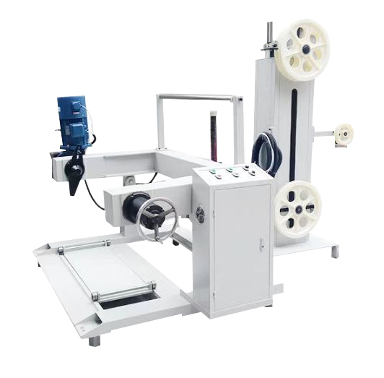
QP-1250 Wire Reel Pay-off Machine
Stepless speed regulation, smooth operation
Independent system, can complete wire feeding without host control
High-quality motor, fast response, high speed
Automatic wire feeding, automatic stop, shaftless power wire feeding
Applicable wire diameter: φ3-φ45
Power supply: AC380V 50Hz/60Hz
Feeding speed: 250m/min
Load capacity: 1.5T
Machine weight: approx. 700Kg
Applicable reel size: Outer diameter φ600-φ1250 Width 550-950
Overall dimensions: 1700*1200*1100mm
Power: ≈5.5KW

Slide 31
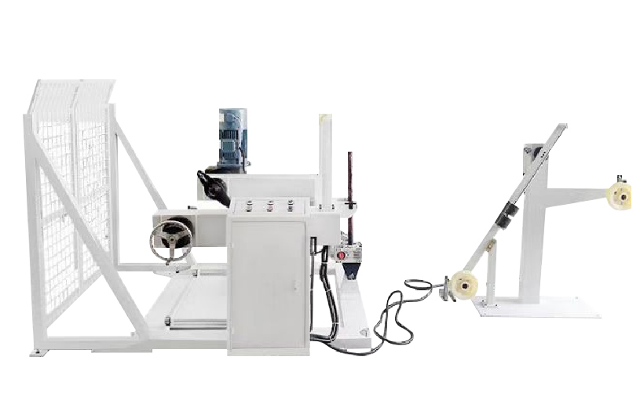
QP-1400 Wire Reel Pay-off Machine
New energy vehicle cables, charging pile cables, power cables, photovoltaic cables, BV wires and other larger cables
Stepless speed regulation, smooth operation
Independent system, can complete pay-off without host control
High-quality motor, fast response, high speed
Automatic wire feeding, automatic stop, shaftless power pay-off
Applicable wire diameter: φ3 - φ45
Power supply: AC380V 50Hz/60Hz
Feeding speed: 250m/min
Machine weight: Approx. 700Kg
Load capacity: 2T
Overall dimensions: 1700*1200*1100mm
Applicable reel size: Outer diameter 700-1400mm, width 550-950mm
Power: ≈5.5kW

